Slide 1
CS425 Introduction to Frequency analysis – Part III

Slide 2
DFT Examples – Digital Cosine Spectrum

Slide 3
In the dB domain – 20*log10()

Slide 4
Scale by the length of the transform 32768

Slide 5
Scale by the length of the transform 32768
Peak magnitude is 0dB

Slide 6
Do the same for a sinewave of frequency 1024Hz

Slide 7
Do the same for a sinewave of frequency 1024Hz

Slide 8
The Digital Spectrum is Infinite
–inf…
….. inf
The spectrum of this cosine extends to infinity

Slide 9
Digital Spectrum
Normally the spectrum is plotted up to Fs/2 but it actually is infinite with repetitions of the spectral information from 0 to Fs/2
The important implication is to remember that actual digital signals are not bandlimited

Slide 10
Component Frequency and Bin frequency do not coincide
If the frequency of the cosine wave is 1024.5Hz then the component does not sit exactly on a frequency bin. This will change the appearance of the frequency spectrum

Slide 11
Cosine frequency 1024.5Hz

Slide 12
Cosine frequency 1024.5Hz

Slide 13
Why the change?
This change in appearance is because the signal under analysis being input to the FFT has an incomplete period
Comparing the two signals it is clear that the end of the 1024Hz signal can connect correctly to its beginning meaning that it has no incomplete periods while for the 1024.5Hz signal this is not true

Slide 14
Compare the two signals 1024Hz
The end of this signal fits perfectly to the start of this

Slide 15
Compare the two signals 1024.5Hz
The end of this signal does not fit perfectly to the start of this

Slide 16
Windowing
This can also be explained by the theory of windowing
A window is essentially looking at a possibly infinite signal through a reduced aperture
In the previous cases we have a rectangular window

Slide 17
Different Windows

Slide 18
In the Frequency Domain

Slide 19
Time and Frequency
Looking at the signal through a window effectively means multiplying the signal by the window in time
This changes the shape of the signal
This changes the spectrum of the signal and the new spectrum is the convolution of the signal spectrum with the spectrum of the window

Slide 20
Windows
Windows are applied a lot in signal analysis to smooth out any discontinuities at the ends of signals when we are computing the spectrum
It may not seem to be important with sinusoids but with real-world signals taking the FFT without windowing can result in lots of spurious spectral components (‘junk’) in the representation

Slide 21
Part of a guitar note waveform

Slide 22
Apply a Rectangular window

Slide 23
Spectrum of Rectangular windowed section

Slide 24
Apply a Hanning window

Slide 25
Spectrum of Hanning windowed section

Slide 26
Apply a Kaiser window

Slide 27
Spectrum of Kaiser windowed section

Slide 28
Window effects
Note that with the rectangular window you can obtain sharp peaks but lots of spectral junk at the base of those peaks
With the more half-cosine windows you get broader peaks but the magnitudes of the junk components are much lower down

Slide 29
Another example of Window Effects on peak appearance

Slide 30
Zero Padding
This is a technique used to gain a better plot from the FFT – often used to bring the length of the signal data for analysis to be a power of two for faster processing
The magnitude output from the FFT is smoother in appearance
In the strictest sense it does not provide better frequency resolution

Slide 31
Zero padding Example

Slide 32
Example 2
There are two cosines at Frequencies 64 and 64.5Hz with a sampling frequency of 512Hz. Zero padding does not reveal the second cosine

Slide 33
Spectrum analysis non-periodic signals
In most practical cases the signals we have are not periodic
Some signals may also be very long so the number of operations to compute the FFT would be prohibitive
It is best then to break such signals into small segments and analyse each one individually with an FFT

Slide 34
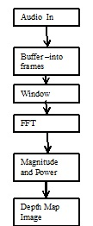
Spectrogram outline

Slide 35
Spectrogram Principle
Its operation principle is that the audio signal is first buffered into frames that are normally overlapping.
The frame sizes are often a power of two in length. The length would reflect the belief in the time duration for which the frequency content in the signal is stationary, for example 10 or 20ms.
The frames are also overlapping and a common choice for the overlap is half the length of the frame.
After this is windowing. The windowing is done to remove the discontinuities at the edges of the frames. The typical window is half-cosine in shape such as a hanning window.

Slide 36
Spectrogram Principle
Zero-padding may then be done to improve the smoothness of the resulting spectrogram.
This is then sent to the FFT. Here, the square magnitude is computed followed by the log10 operation to convert into dB which displays the power at each frequency bin.
The succession of FFTs is then displayed as a depth map where regions of higher spectral information appear as a darker or lighter intensity in the image.

Slide 37
Spectrogram
This 2-dimensional data set requires a three-dimensional graphic display
This is usually done by plotting contour plots or gray-scale images
The preferred form is the spectrogram where the gray level at the each point is proportional, where large values are black and small values are white

Slide 38
The Spectrogram
The horizontal axis is time and the vertical axis is frequency
The minimum shift of the sliding window is one sample point
However, it is not always necessary to compute the spectrogram at every time instant especially is the spectral content of the signal is not changing rapidly over time

Slide 39
Sliding the window - hopping
Instead it is possible to skip over some of the time instants without losing the basic shape of the spectrogram
This means that the sliding window is moved by more than one sample each time, this is called the hop size

Slide 40
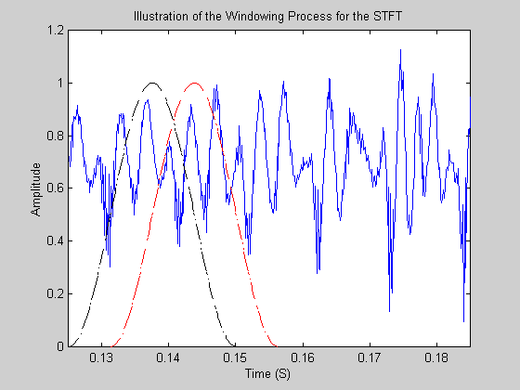
Window Hopping

Slide 41
Window Functions
There are actually a number of different window functions available, with the Rectangular being a specific case
The properties of the different windows have an effect on how the information will be displayed on the spectrogram

Slide 42
Connecting Windows and Filters
The DFT equation is
If we are windowing we can write it as
where n₀ is the time point at which we window the signal

Slide 43
Rectangular window
If we use a rectangular window its equation is

Slide 44
Filter interpretation
We can interpret the equation as a filtering operation where the filter is given by the combination of the window and the Fourier complex exponentials. Note how it looks like a convolution…

Slide 45
Filter Interpretation
The term
Describe a bandpass filter whose centre frequency is given by (k/N) F_{s}
The window w[m-n₀] represents a low pass filter impulse response that is shifted in the spectrum to become a bandpass filter

Slide 46
The Lowpass Spectrum of a Rectangular Window

Slide 47
Bandpass filter interpretation
The spectra of a number of rectangular windows behaving as bandpass filters

Slide 48
Rectangular window
In the case of the Rectangular window its spectrum is wider than the width of each frequency component being measured leading to leakage from other frequency components present in the signal into the calculation
This means that the accuracy of our spectral representation is compromised

Slide 49
Different Windows
To overcome the problems with the rectangular window, efforts have been directed towards designing windows that taper at the ends to give a more gentle weighting on the data
One well-known and commonly used window is the Hanning window

Slide 50
Different Windows
Another window used widely is the Hamming window
For the Hamming window, its sidelobes are much lower than those of the rectangular window. However, the compromise is that the central lobe of the main window is broader, about twice as wide. This is the compromise in choosing a window

Slide 51
Spectrogram Parameters
Two parameters are involved in the calculation of the spectrogram
1. The window length L
2. The number of analysis frequencies N (i.e. zero padding)
Its resolution performance is assessed in frequency and time. Resolution can be measured by determining its performance when processing two closely spaced components, either in frequency or time

Slide 52
Window Length
The length of the window determines the width of its passband, and thus, impacts the frequency resolution
The hanning window has a passband width that is approximately equal to 2π4/L
However, if L is large, then the time resolution suffers and Short-duration time events or time transitions are lost when combined together by a long window

Slide 53
Short and Long Window Spectra
Short=blue line
Long= red line
The Spectra of Short and Long Windows

Slide 54
Time/Frequency Resolution trade-off
Good time resolution and good frequency resolution cannot be obtained simultaneously in the spectrogram
This is called the uncertainty principle and is equivalent to the Heisenberg principle in physics

Slide 55
Sinusoid Example
The test signal is comprised of two components:
A 960Hz tone that persists over the entire data set and a 1000Hz tone whose beginning and ending times are 100 and 400msec respectively
Using a Hanning window,

Slide 56
Sinusoid Example
The time resolution is directly proportional to the length of the window
The trade-off between time and frequency resolution can be seen for the cases L=512 and L=128

Slide 57
Predicted Resolutions

Slide 58
Short and Long Window Resolution
The frequency resolution of the longer window (L=512) is adequate to resolve the two signals, but it causes a blurring of the signals endpoints, which inhibits an accurate calculation of the starting and ending times
The shorter window (L=128) does find the ends of the signal but fails to resolve the two frequencies

Slide 59
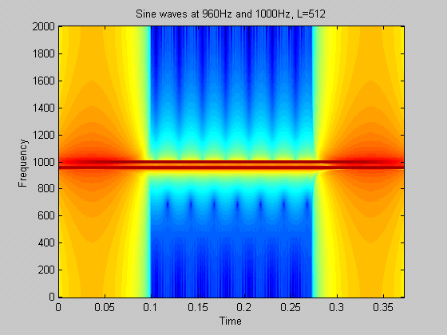
Good Frequency Resolution

Slide 60
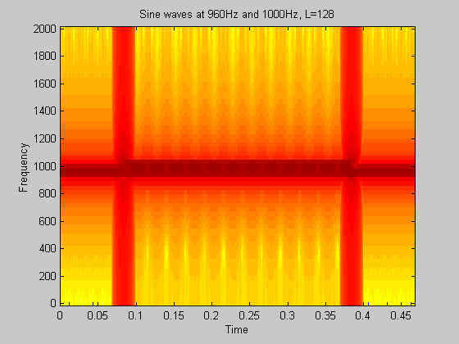
Good Time Resolution

Slide 61
The Spectrogram for Speech
Choice of window length:
Narrow band analysis: resolves harmonics but blurs temporal detail such as burst onsets.
Wide band analysis: resolves fine temporal detail but looses fine frequency detail.
In most applications this tradeoff is manifested as the choice of window size. Good rule of thumb is to include a few pitch periods, say 20ms to 32ms.

Slide 62
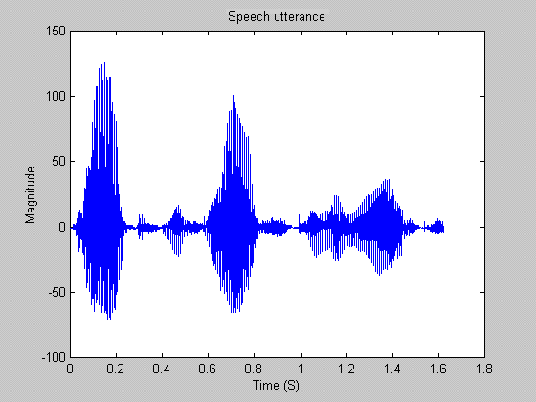
Speech Waveform

Slide 63
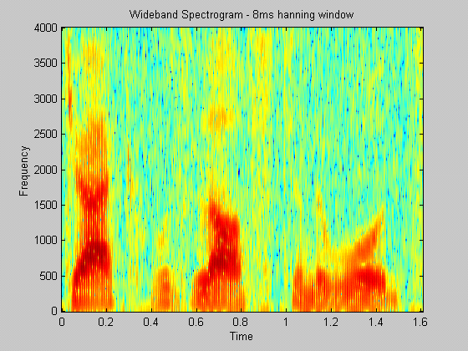
Short Window - Good time Resolution
Formants visible but no harmonics

Slide 64
In Detail

Slide 65
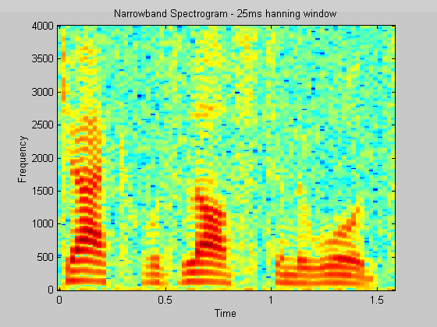
Long Window - Good Frequency Resolution
Smearing exists at the beginning and end of events

Slide 66
In Detail

Slide 67
Heisenberg Uncertainty
Basically - we cannot know exactly what spectral components exist at what instances in time
One explanation is a tiling interpretation of the spectrogram where the shape of the tiles depict the region of uncertainty in the time-frequency plane regarding the frequency and location of a component.

Slide 68
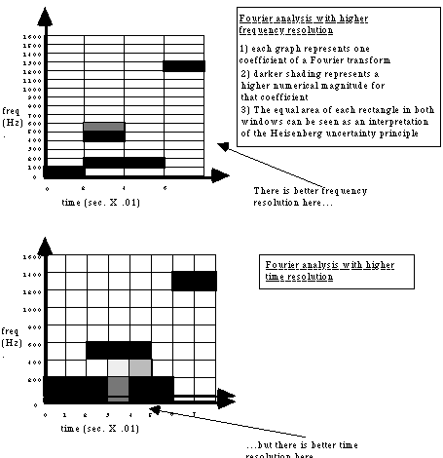
The Tiling Interpretation

Slide 69
The Fast Fourier Transform
To evaluate all of the X[k] coefficients of the DFT, we need N multiplies and N-1 additions
The FFT provides a means of evaluating the DFT and IDFT equations with a number of operations proportional to N log₂N
rather than N²
This behaviour becomes increasingly important for large values of N

Slide 70
The Fast Fourier Transform
For example, if N=1024
The FFT will compute the coefficient set with 5120 complex multiplications
Direct evaluation of the DFT will result in 1,048,576 complex multiplications
The algorithm works best when N is a power of two. However, no savings are made if N is a prime number

Slide 71
Convolution
A special mathematical operation that is well-known in signal processing
$y\left[n\right]=\sum_{k=0}^{N−1}{h\left[k\right]x\left[n−k\right]}$
The signal y is the convolution of the signals x and h

Slide 72
Example of Convolution
Consider the signals x[n]={2, 6, -1, -2} and h[n]={5, -3, 1}
n | 0 | 1 | 2 | 3 | 4 | 5
x[n] | 2 | 6 | -1 | -2
h[n] | 5 | -3 | 1
h[0] x[n-0] | 10 | 30 | -5 | -10
h[1] x[n-1] |  | -6 | -18 | 3 | 6
h[2] x[n-2] |  |  | 2 | 6 | -1 | -2
y[n] | 10 | 24 | -21 | -1 | 5 | -2

Slide 73
More Detail
n | 0 | 1 | 2 | 3 | 4 | 5
x[n] | 2 | 6 | -1 | -2
h[n] | 5 | -3 | 1
h[0] x[n-0] | h[0] x[0] | h[0] x[1] | h[0] x[2] | h[0] x[3]
h[1] x[n-1] |  | h[1] x[0] | h[1] x[1] | h[1] x[2] | h[1] x[3]
h[2] x[n-2] |  |  | h[2] x[0] | h[2] x[1] | h[2] x[2] | h[2] x[3]
y[n] | 10 | 24 | -21 | -1 | 5 | -2

Slide 74
Algorithm for Convolution
Draw a grid and then write out the n across the top where n=length(x)+length(h)-1, i.e. (4+3-1=6). n has 6 elements which means 0, 1,2 3, 4, 5.
You have a diagonal arrangement
First row is the h[0] by x[0] to x[3]
Second row is the h[1] by x[0] to x[3] (shifted by 1 relative to the first row)
Third row is the h[2] by x[0] to x[3] (shifted by 2 relative to the first row)
Add down the columns to get the final number.

Slide 75
Convolution Operation
Sometime the Convolution operation is described as a folding and shifting
Convolution is used to describe the actions of filters on signals

Slide 76
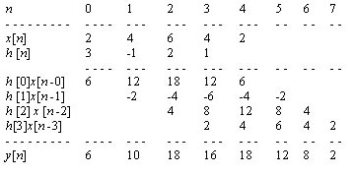
Convolution Example 1

Slide 77
Convolution Example 2
Convolve the two sequences
X=[1 4 -2 5] and h=[ 1 -1 0.5 2.6]
Y=[1 3 -5.5 11.6 4.4 -2.7 13]

Slide 78
Resources for Convolution:
https://www.youtube.com/watch?v=KuXjwB4LzSA&t=435s
https://www.youtube.com/watch?v=acAw5WGtzuk

